Slide 1

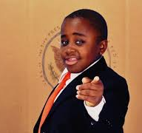

KID PRESIDENT
Robby Novak

Slide 2
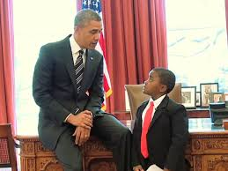
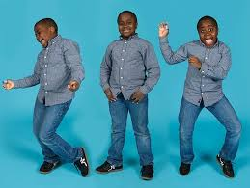
Robby Novak, now 16 years old, is an actor best known for portraying the character Kid President online and on television. He has a series of YouTube videos and a television show. His “Kid President” video has been viewed 12 million times online. In it, Robby gives the world a pep talk, but it’s his life off camera that’s the real inspiration.

Slide 3
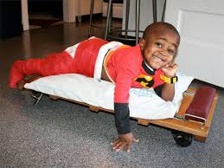
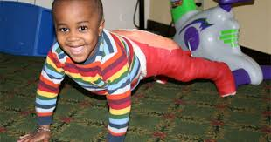
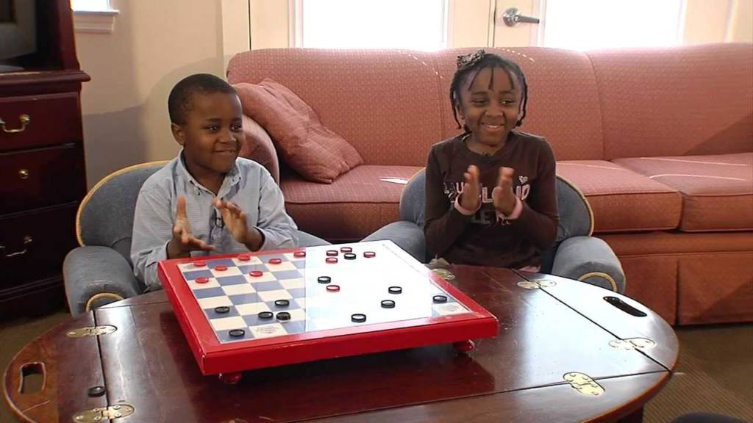
Robby Novak suffers from osteogenesis imperfecta, a disease that makes his bones brittle. But the smiling Youtube sensation doesn’t let his frequent injuries slow him down.
In fact, Robby has had more than 70 broken bones and 13 surgeries! He has steel rods in both legs.
Despite his condition, he keeps a great, upbeat attitude.
Robby and his sister Lexi, who also has brittle bone disease, were adopted by Lori and David Novak. Laurie and David have been caring for the siblings since Lexi was 17 months old and Robby was 2 months old. They have never held Lexi or Robby back from doing what they love and experiencing life.

Slide 4
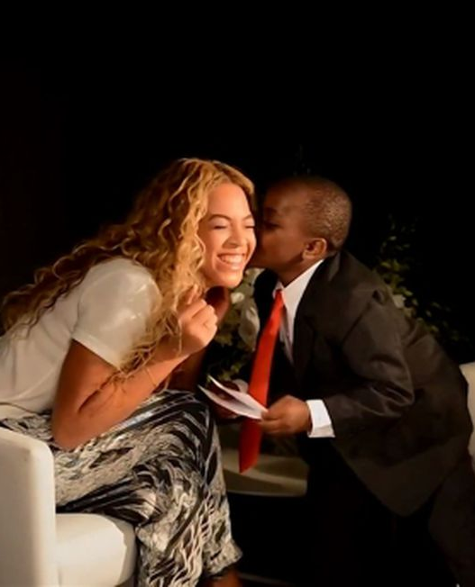

Kid President has met Beyonce as well as many other celebrities!
He has also written a New York Times Best Selling Book called Kid President's Guide to Being Awesome!

Slide 5
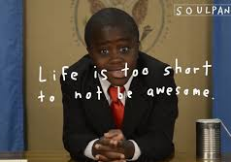
KID PRESIDENT
Robby Novak

Slide 6
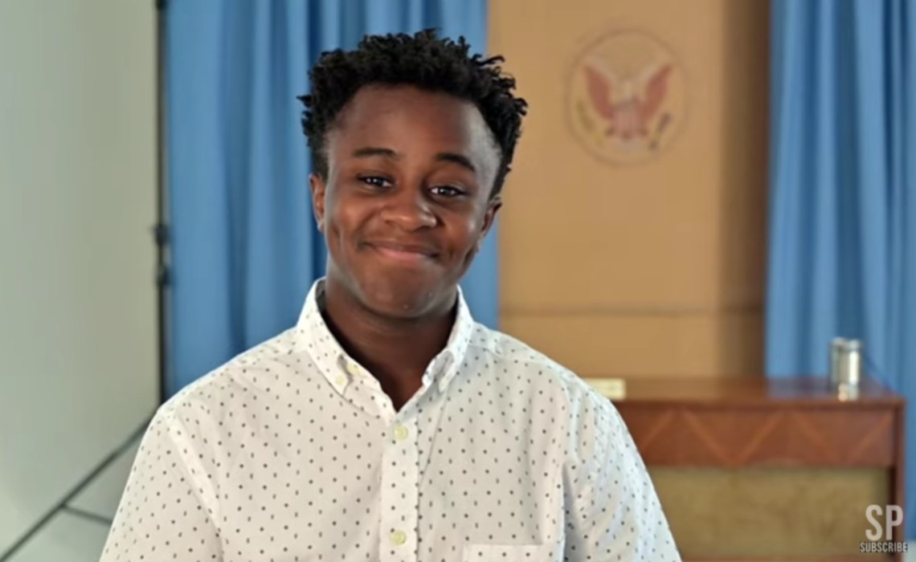

Kid President-- Today

